Slide 1

Parallel models: training many parallel models for hierarchical time series optimization
Vanja Paunić
John-Mark Agosta
Microsoft
TUTORIAL MATERIAL:
https://github.com/Azure/Azure-MachineLearning-DataScience/tree/master/Misc/KDDCup2016
ROOM: Embarcadero
Parc 55 San Francisco,
55 Cyril Magnin St, San Francisco, CA
TIME: 9:00am - 12:00pm
August 17th, 2016, KDD 2016, San Francisco
2016

Slide 2
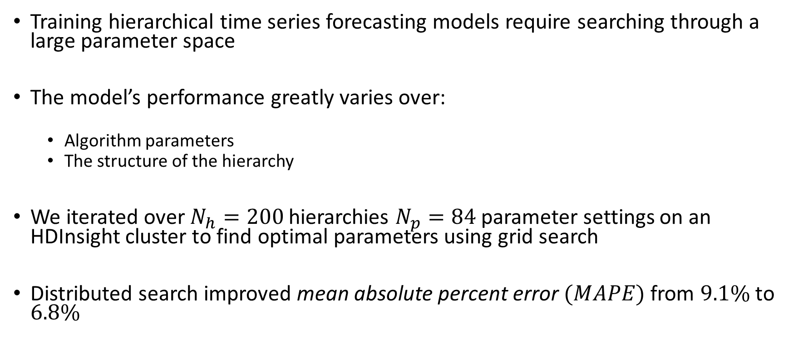
Motivation
Training hierarchical time series forecasting models require searching through a large parameter space
The model’s performance greatly varies over:
Algorithm parameters
The structure of the hierarchy
We iterated over $N_{h}=200$ hierarchies $N_{p}=84$parameter settings on an HDInsight cluster to find optimal parameters using grid search
Distributed search improved mean absolute percent error $(MAPE)$ from 9.1% to 6.8%

Slide 3
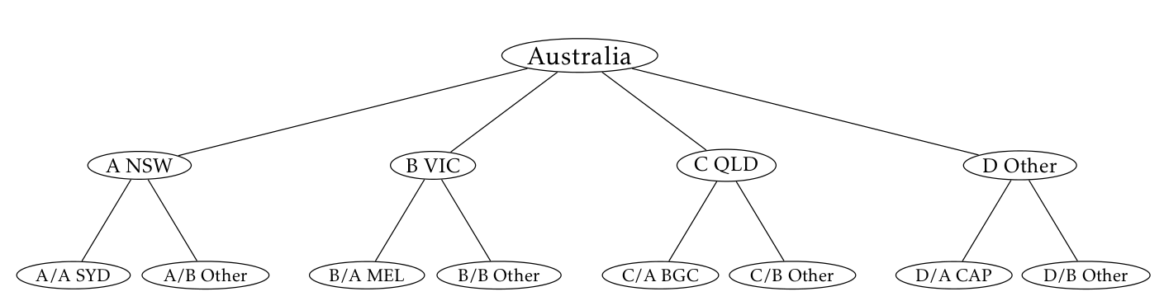
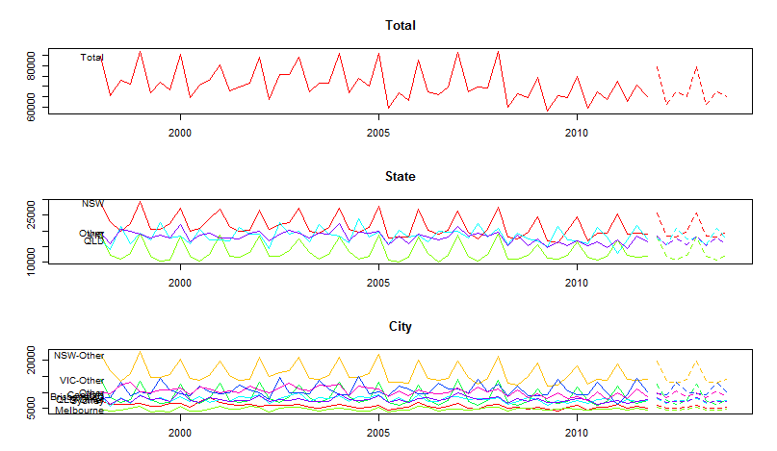
Hierarchical Time Series (HTS) Example
Australian tourism data set
Forecasting nights spent by tourists in Australia:
In total
By state
By city
Several approaches:
Bottom up
Top down
Middle out
Combination
Image source: https://www.otexts.org/fpp/9/4

Slide 4
Real life example
Customer demand forecasting disaggregated by eight variables
Middle out approach
Hierarchical time series forecasting to level L, then disaggregate the forecast down using historical proportions
Total
Customer 1
CT1
CT2
Customer 2
CT1
Aggregate
By Customer
By Container
By Destination
CT2
…
US
China
…
US
China
…
…
By Origin
…
…
…
…
…
….
…
…
…
(FOUR more variables / levels)

Slide 5
Search space complexity
Search space:
Algorithm parameters
The structure of the hierarchy
Total search space ~17000!
HPC rather than Big Data problem
Small cluster suffices
HDInsight cluster with 4 nodes, 32 cores
ts_method <- c("arima", "ets", "rw")
hts_method <- c("bu", "comb", "tdgsa", "tdgsf", "tdfp")
comb_hts_weights <- c("sd", "none", "nseries”)
hist_prop_window <- c(3, 6, 9, 12)
Customer
Commodity
Commodity

Slide 6
Iterative optimization
Iterative optimization made the search space tractable
Default settings
Vary parameters
MAPE
Baseline
MAPE = 9.1%
MAPE
Vary hierarchy

Slide 7
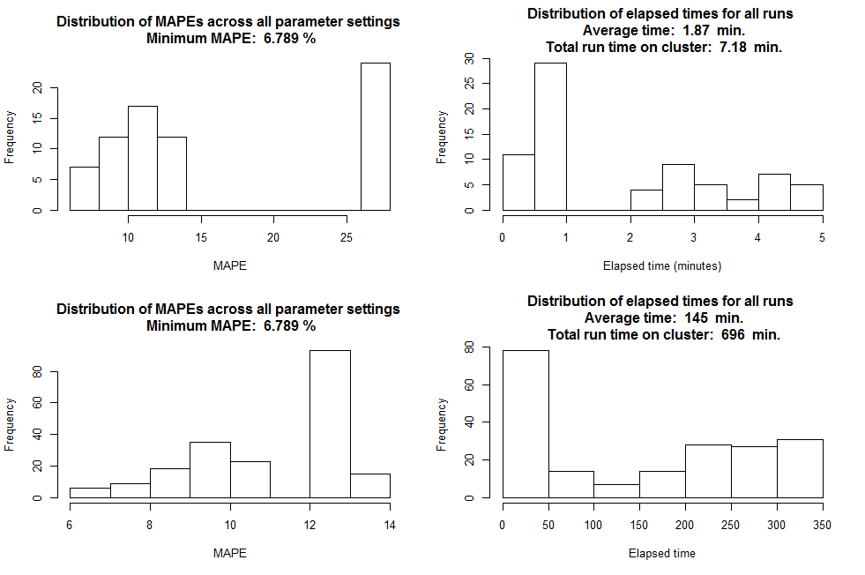
RESULTS (LAST ROUND) DEFAULT HIERARCHY VARYING PARAMETERS Minimum MAPE: 6.789 % Optimal historical window for top-down proportions: 3 months Optimal method for distributing forecasts within the hierarchy: Bottom-up Optimal forecasting method: Arima Number of jobs: 84 Total execution time: 7.183 min. Average run execution time: 1.872 min. DEFAULT PARAMETERS VARYING HIERARCHY Minimum obtained MAPE: 6.789 % Best vars to run statistical forecast on: Commodity, Container Number of jobs: 200 Total execution time: 695.7 min. Average run execution time: 144.6 min.

Slide 8
Results
MAPE improved from 9.1% to 6.8%
Total execution time ~1 day, if ran serially it would take ~40 days
Optimal result was counterintuitive compared to the initial guess
“Middle-out” approach avoids problems with highly disaggregated time series
Conclusion
R Server on HDInsight cluster allows for an efficient search of the parameter grid to find optimal model parameters
For many HPC problems, a small cluster may be sufficient

Slide 9
Thank you!
References:
Sample demo on the tutorial github: sample_demo.R
http://tinyurl.com/KDD2016RCode/UseCaseHTS
HDInsight
https://azure.microsoft.com/en-us/services/hdinsight/
Hyndman, R.J. and Athanasopoulos, G. (2013) Forecasting: principles and practice. OTexts: Melbourne, Australia. http://otexts.org/fpp/.

